Slide 1




Slide 2
AI POWER CROP HEALTH AND PEST MONITORING
~TECH BOOM

Slide 3
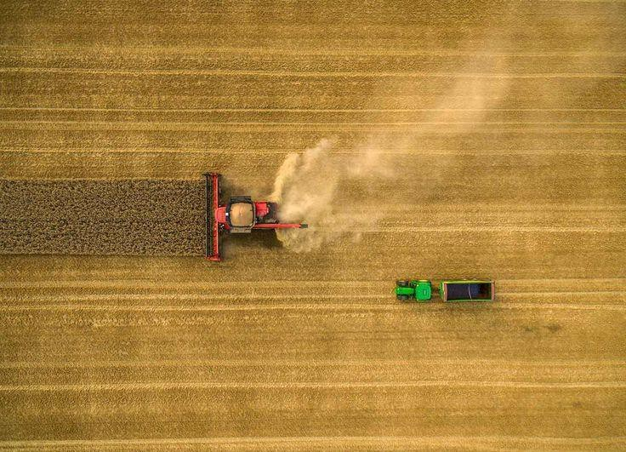
Agriculture is highly affected by pests and diseases.
Traditional monitoring methods are time-consuming and inaccurate.
Al-based monitoring improves detection, efficiency, and yield.

Slide 4
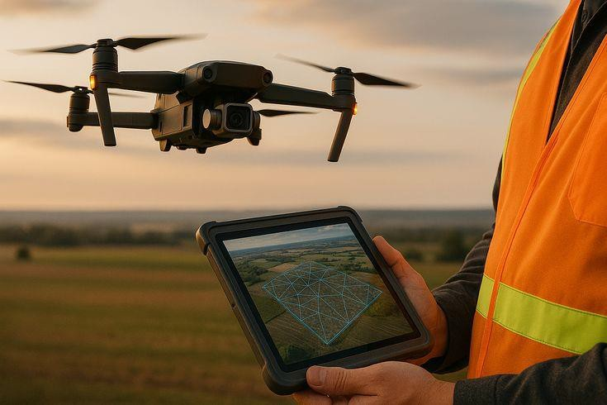
Introducing Al
Traditional Methods
Al for Pest Monitoring
Benefits For UK
Agriculture
Overcoming Hurdles
Cultivating Tomorrow

Slide 5
Introducing AI
Artificial Intelligence is transforming agriculture by offering unparalleled capabilities for precision, efficiency, and sustainability. Al- driven systems. can process vast amounts of data, identify subtle patterns, and provide actionable insights.

Slide 6
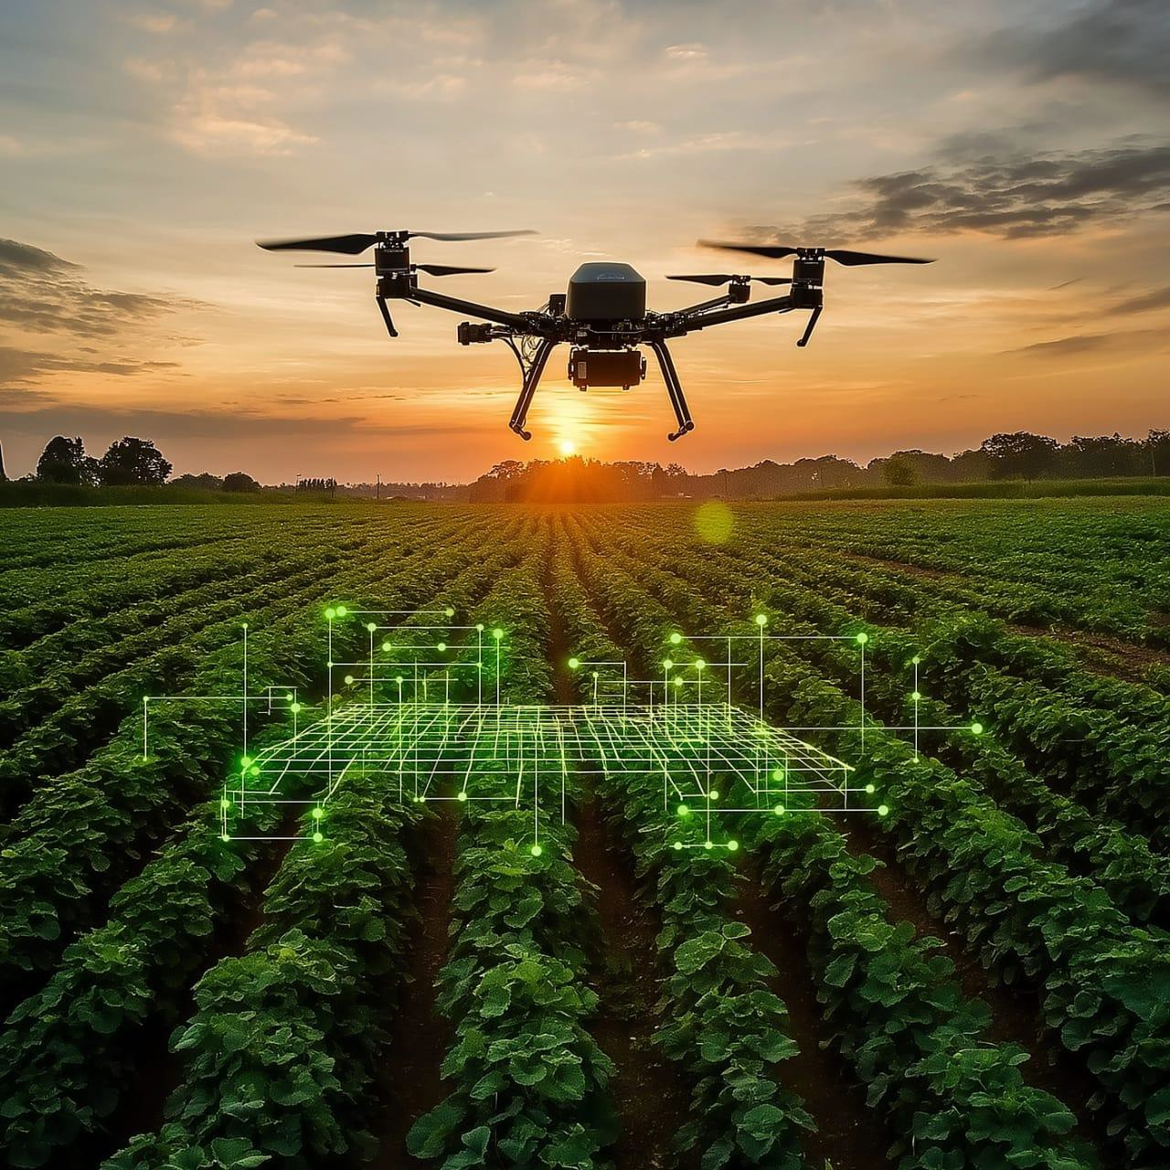
Ai For Pest Monitoring:
Automated Scouting
Drones and ground robots equipped with Al cameras continuously monitor fields, identifying pests without human intervention.
Species Recognition
Al models accurately classify insect species, distinguishing between harmful pests and beneficial insects.
Infestation Prediction
By analysing historical data and environmental factors, Al predicts
potential outbreaks, allowing for preventative measures.
Targeted Control
Enables precise application of pest control, reducing pesticide use and protecting non-target organisms.

Slide 7


Increased Productivity
Benefits for
Optimised resource use and early intervention lead to significant improvements in cropyields.
UK
Reduced Chemical Input
Agriculture:
Boosting
Precision agriculture minimises the need for broad-spectrum pesticides and fertilisers, benefiting soil and water quality.
Yields and
Enhanced Sustainability
Al contributes to more environmentally friendly farming practices, aligning with I
national sustainabilitygoals.
Reducing
Clne@'ilical Use
ForUK farmers, Al offers a pathway to moreresilient, productive, and ecologicallyI
I
sound agricultural practices, addressing both economic viability and environmental stewardship.

Slide 8
Cultivating Tomorrow: Key Takeaways and the Path Ahead
Ill
1. Al is Transformative
It offers unprecedented capabilities for precision agriculture, revolutionisingcrop and pest management.
Enhanced Sustainability
Reduces chemical use, conserves resources, and builds more resilient farmingsystems for the future.
Proactive Solutions
Moves farming from reactive to predictive, enabling early intervention and optimisingyields.
4. Collaborative Future
Requires partnerships to overcome challenges and ensure equitable access to these powerful technologies.
2.
3.
The integration of Al intoagriculture is not just an incrementalimprovement; it is a fundamental shift towards a more intelligent, efficient,and sustainable foodproduction system. Let us embrace this future,cultivatinghealthier crops fo a healthier world.

Slide 9


